Slide 1

Western Pennsylvania Regional Data Center
Bob Gradeck
University of Pittsburgh
Center for Social and Urban Research
twitter: @WPRDC, @BobGradeck
email: wprdc@pitt.edu
ucsur.pitt.edu
Notes:
Provide services to campus and broader community
http://www.communications.pitt.edu/Graphic-Standards.pdf

Slide 2



History as an Information Intermediary
Notes:
What type of role does your organization play – organizer, convener, project manager, idea generators, “data lobbyist”, others, none of these?

Slide 3
Over the years, we produced many neighborhood and community indicators reports.

Slide 4
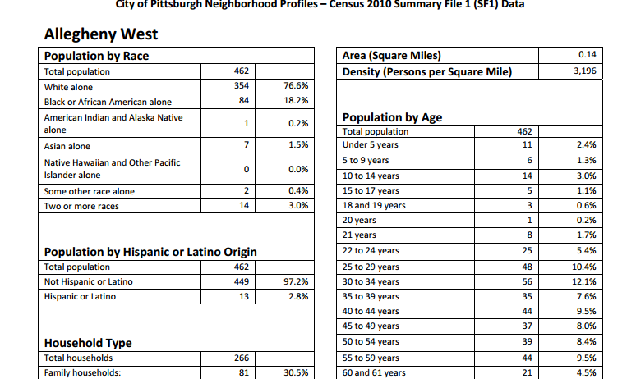

Slide 5
We operated a GIS server where organizations could make maps and view data

Slide 6
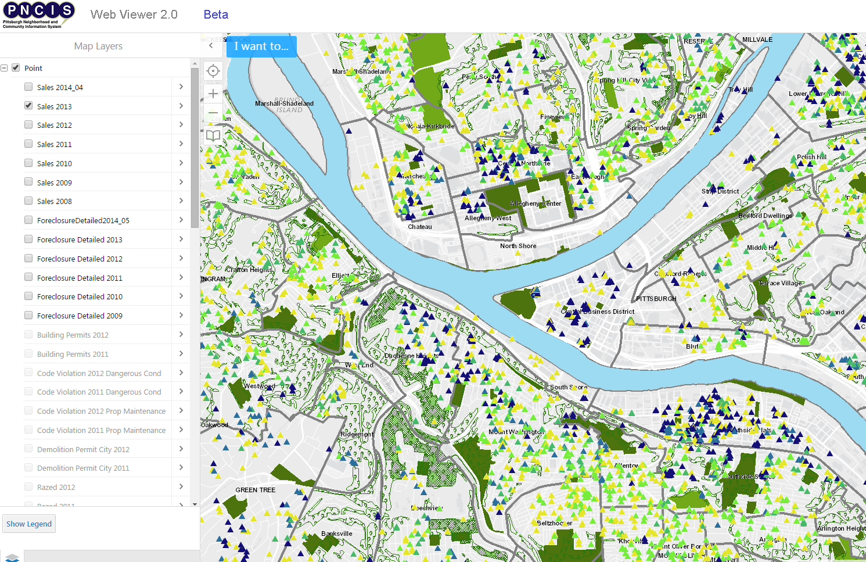

Slide 7
We also conduct research and provide technical assistance to government and community organizations

Slide 8
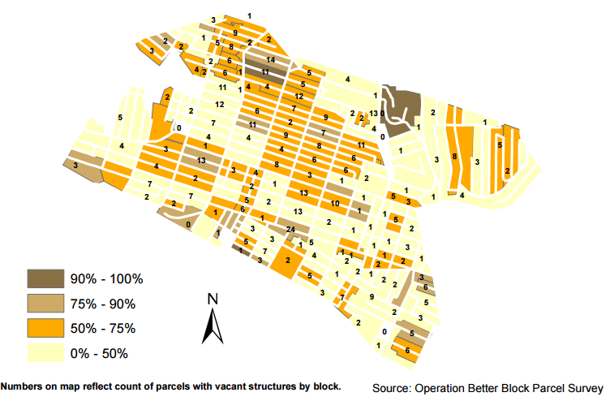

Slide 9
We’re now moving into the world of open data.

Slide 10
What is open data?
I’m glad you asked...

Slide 11
Open data is a complete set of primary data made easily and permanently available.

Slide 12


Open data does not contain sensitive personally-identifiable
information (PII).

Slide 13
Open data places no unreasonable restrictions or barriers on accessibility, sharing and re-use.

Slide 14
Open data is provided through electronic, machine readable, non-proprietary file formats.

Slide 15







Data Center Project Structure
Data Providers
Data Users
Government
Academic
Government
Non-Profit
Academic
Journalists
Open Data Portal
Non-Profit
Residents
Businesses
Notes:
manage, document, publish > find and access > events, resources, technical assistance > make requests

Slide 16

Eight reflections and observations informed the Data Center’s structure.
http://hpwren.ucsd.edu/a_and_d.html
Notes:
Growing demand for information
Raw data
Aggregate data (reports)
Publishers not equipped to respond to data requests,
Knowledge of data use not always shared
Ad-hoc development of data ecosystem - few strategic capacity investments and lack of infrastructure
http://hpwren.ucsd.edu/a_and_d.html

Slide 17
1. Demand for data is growing. Most people either want raw data or aggregate data that describes a place
http://hpwren.ucsd.edu/a_and_d.html
Notes:
Growing demand for information
Raw data
Aggregate data (reports)
Publishers not equipped to respond to data requests,
Knowledge of data use not always shared
Ad-hoc development of data ecosystem - few strategic capacity investments and lack of infrastructure
http://hpwren.ucsd.edu/a_and_d.html

Slide 18
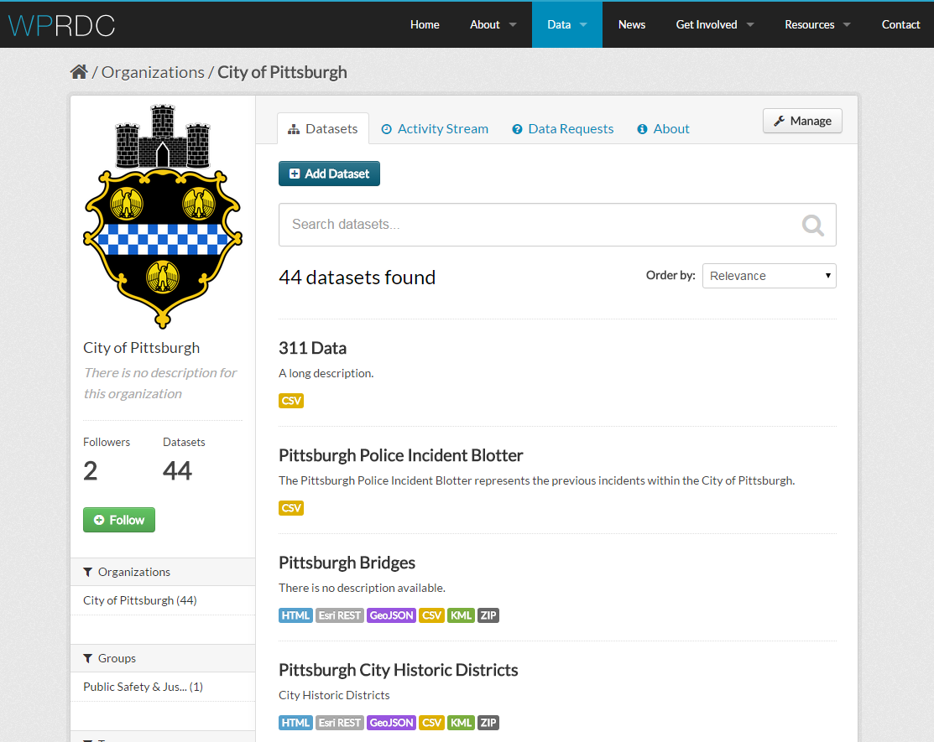
Raw Data: Western Pennsylvania Regional Data Center

Slide 19
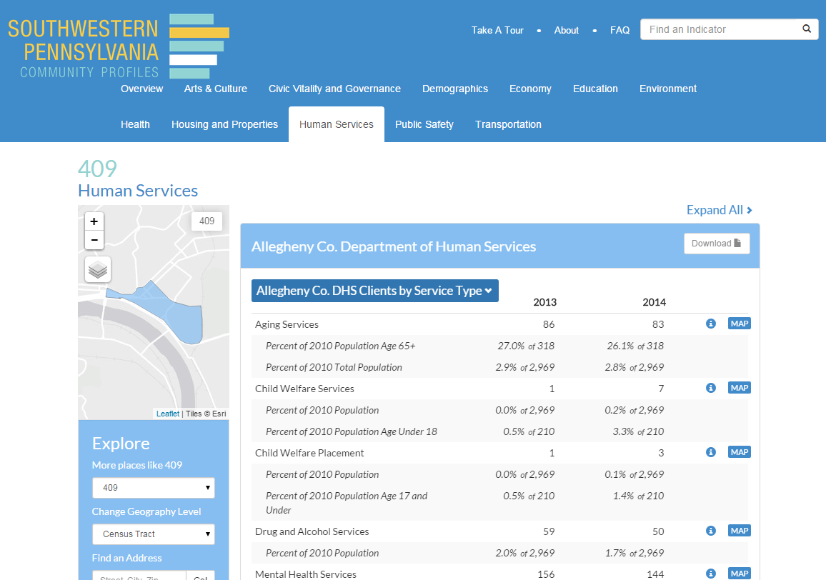
Local Indicators: Southwestern Pennsylvania Community Profiles

Slide 20
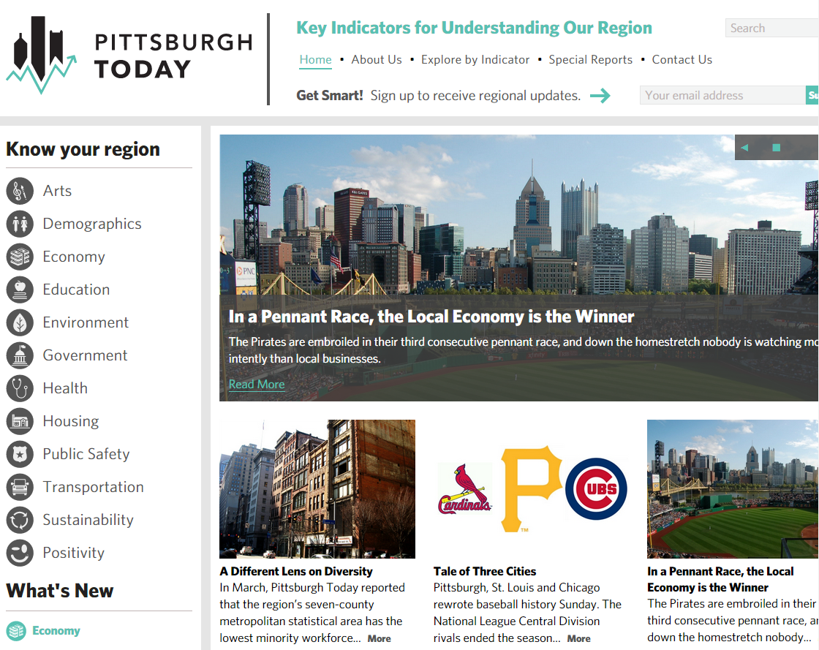
Regional Indicators: Pittsburgh Today

Slide 21
2. People want to use their own tools to explore data.
http://hpwren.ucsd.edu/a_and_d.html
Notes:
Growing demand for information
Raw data
Aggregate data (reports)
Publishers not equipped to respond to data requests,
Knowledge of data use not always shared
Ad-hoc development of data ecosystem - few strategic capacity investments and lack of infrastructure
http://hpwren.ucsd.edu/a_and_d.html

Slide 22
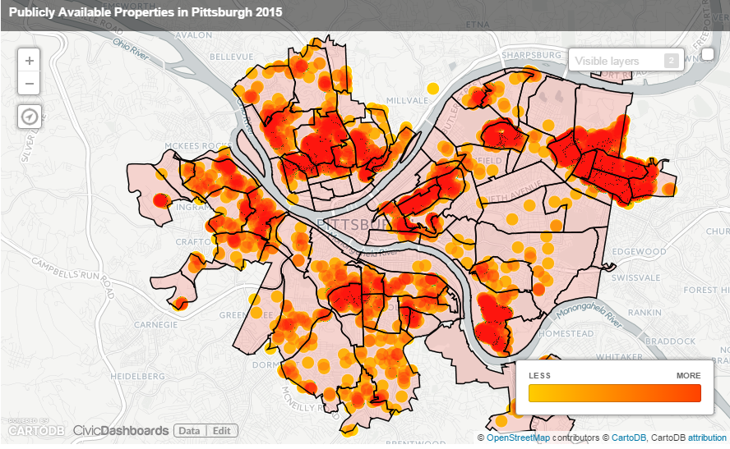
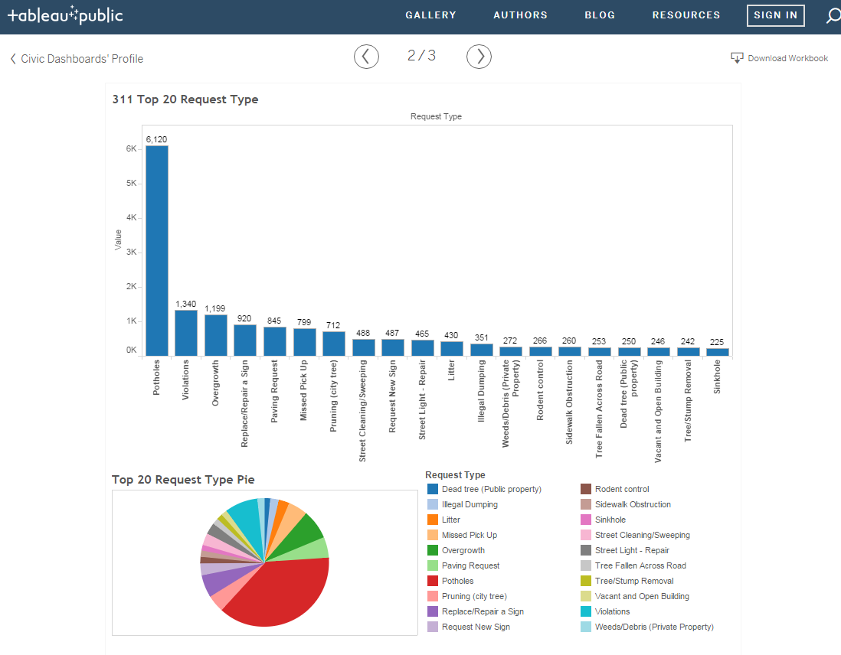
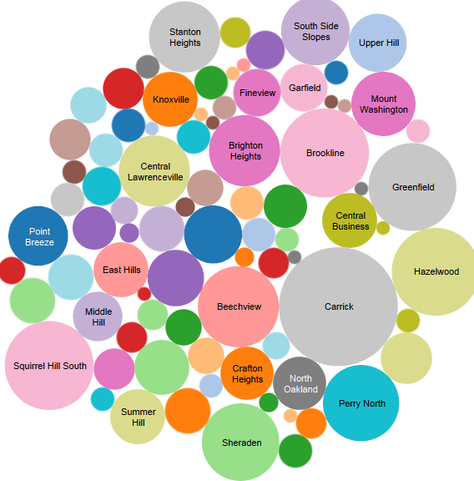

Slide 23
3. Problems cross borders. Data often does not.
http://hpwren.ucsd.edu/a_and_d.html
Notes:
Growing demand for information
Raw data
Aggregate data (reports)
Publishers not equipped to respond to data requests,
Knowledge of data use not always shared
Ad-hoc development of data ecosystem - few strategic capacity investments and lack of infrastructure
http://hpwren.ucsd.edu/a_and_d.html

Slide 24
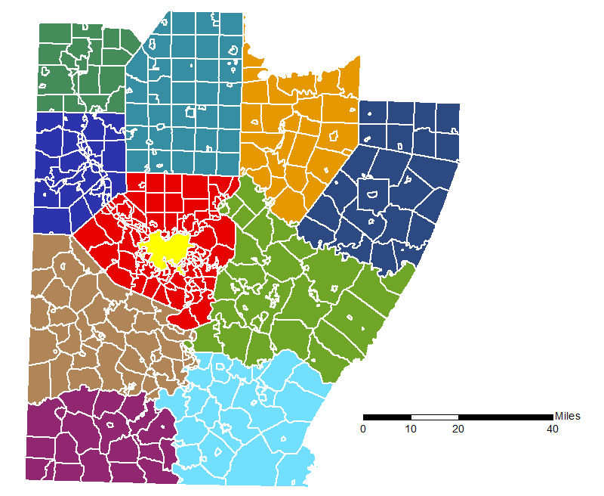

Slide 25
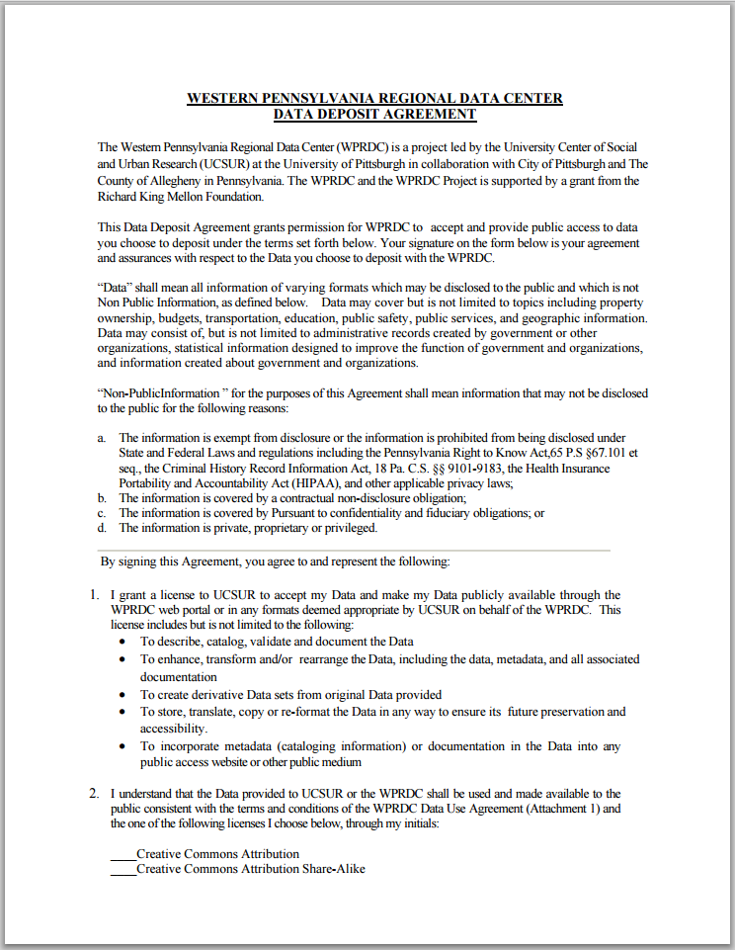
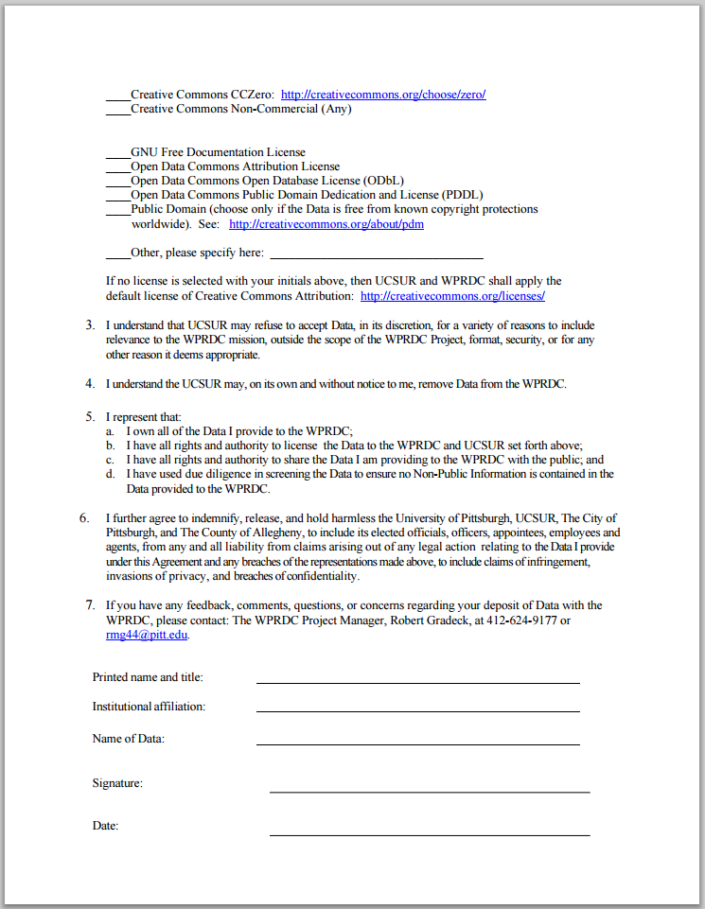
Two-Page Data Deposit Agreement for New Publishers
Government
Non-Profit
Academic

Slide 26
4. Most data owners are not good at publishing.
http://hpwren.ucsd.edu/a_and_d.html
Notes:
Growing demand for information
Raw data
Aggregate data (reports)
Publishers not equipped to respond to data requests,
Knowledge of data use not always shared
Ad-hoc development of data ecosystem - few strategic capacity investments and lack of infrastructure
http://hpwren.ucsd.edu/a_and_d.html

Slide 27
Publisher Training and Technical Assistance
Loading data
Writing metadata
Protecting sensitive information
Prioritizing data releases
Adopting data standards

Slide 28
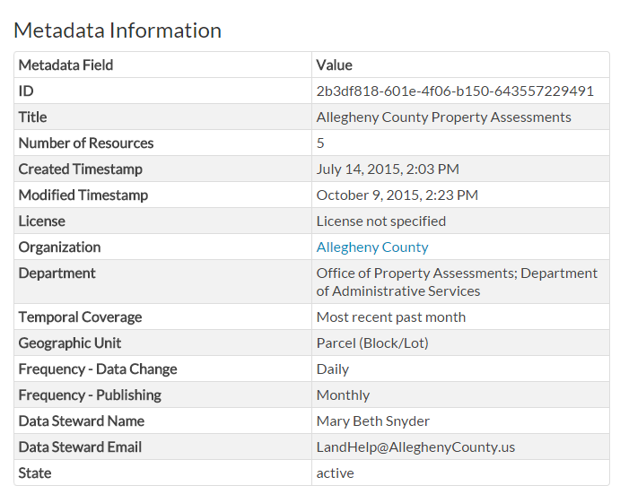
Metadata for All Data
Metadata is a structured framework for documenting data.
It’s essential if anyone hopes to find and use your data.

Slide 29
Licenses for All Data (or Public Domain Dedication)
Allow data owners to set terms and conditions
Allow users to understand terms and conditions

Slide 30
5. Data is like bread. It gets stale over time.
http://hpwren.ucsd.edu/a_and_d.html
Notes:
Growing demand for information
Raw data
Aggregate data (reports)
Publishers not equipped to respond to data requests,
Knowledge of data use not always shared
Ad-hoc development of data ecosystem - few strategic capacity investments and lack of infrastructure
http://hpwren.ucsd.edu/a_and_d.html

Slide 31

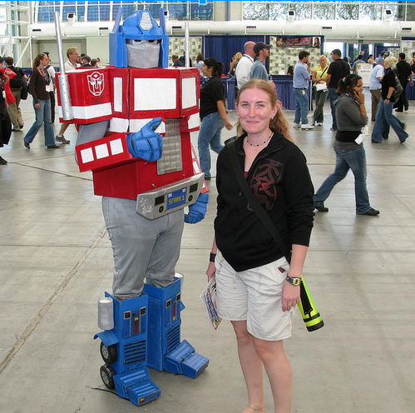
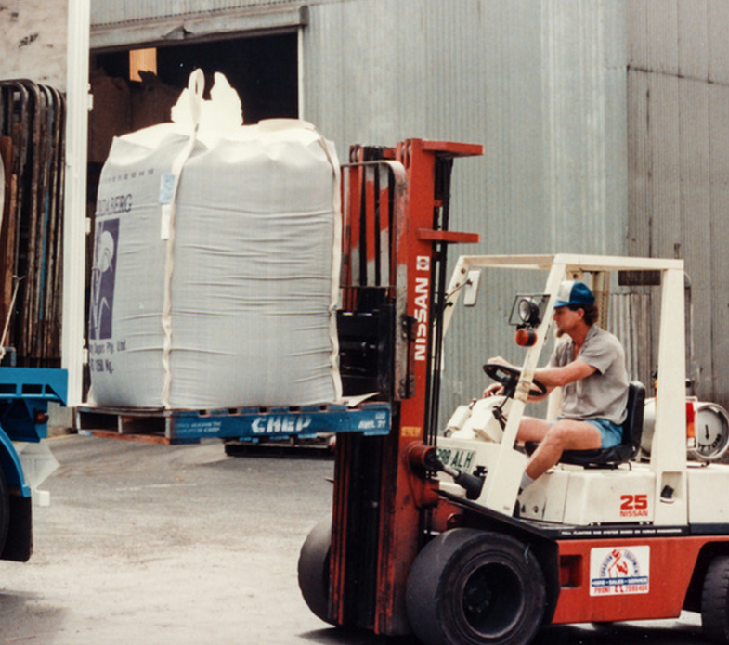
Goal: Automated Publishing of Key Data
Extract
Transform
Load

Slide 32
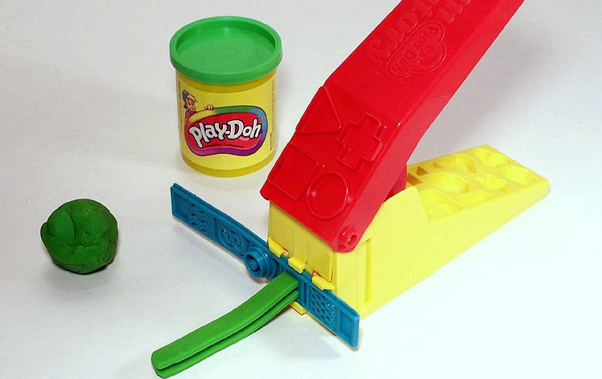
This ball of Play-Doh represents messy data

Slide 33
1. EXTRACT messy data out of an external system
This ball of Play-Doh represents messy data

Slide 34
1. Extract messy data out of an external system
2. Build and use tools to TRANSFORM data into something more-useful…
This ball of Play-Doh represents messy data

Slide 35
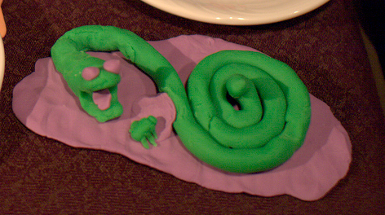
3. We LOAD it to our systems so you can build something with the data!
Notes:
https://www.flickr.com/photos/wilsonh/5051225193/in/photolist-8GmRgx-r6zukk-4cQpR1-9zP1hV-btKBhP-dUd9Fu-95tCAB-5QiLPR-4LRjva-4LVuay-4LVu4G-cT1JNJ-5zAZTB-dqdN9m-jYAcwx-m2Xprs-m2VYHH-m2WwXa-8GmQtk-8Gq1Qq-wuzSRi-9uUZg6-8rRqP9-7puTDL-29L5F2-3pSyf-FWmo1-qGxHjR-65s5Rh-4JhKtd-8Pi8xT-8PmdSC-8PmdpS-5hhUS8-5Nz677-34sseD-EAodE-fQsQUm-bfvimT-qYQmNE-4nQUwg-4NAcGb-aE4a5x-79ZrZA-BpSvj-46ZiWU-2kqRDh-8nz8Ss-aE2Yjo-4mF7fE
https://www.flickr.com/photos/laptop006/2081615534/in/photolist-4aWPM1-4aWKe9-4aSDgZ-4aSyFr-4aStVB-4aSpgz-4aSjEn-3HidBH-4ixV9G-9PNA6x-A8AW-opc7We-d1YsYS-dCEdCt-cFhCZC-cFhCQA-97z1R7-97vVt6-cFhCEC-611YPw-uQG39L-d2kYab-9PRsGE-8MbgTo-8Pi7Pa-6SzjTh-aseiGX-4Cpnos-mycVHR-dmJo1J-czn24u-cbfETm-9JKQZx-9sQaLh-8Pi7G6-aqi95m-7qofzM-8TLVUQ-8nvZKK-7ZJTmp-dNMHoL-dLQ5EQ-dKYLnP-dL5dMU-FUmrg-82E4K-rw24nh-rNAUtD-qRB183-i7htb5

Slide 36
6. People don’t talk to each other about how they’re using data (or want to use it).
http://hpwren.ucsd.edu/a_and_d.html
Notes:
Growing demand for information
Raw data
Aggregate data (reports)
Publishers not equipped to respond to data requests,
Knowledge of data use not always shared
Ad-hoc development of data ecosystem - few strategic capacity investments and lack of infrastructure
http://hpwren.ucsd.edu/a_and_d.html

Slide 37
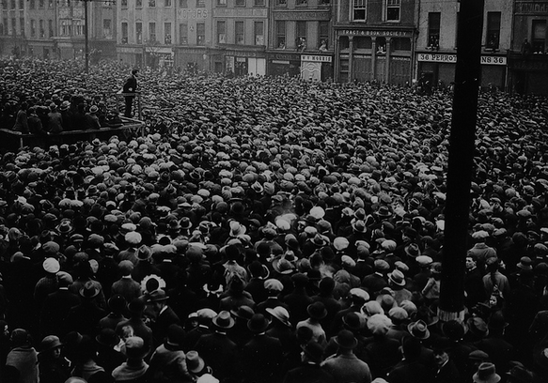
Data User Groups
Using data as a basis for shared conversation
Rotating topics
Open to everyone

Slide 38
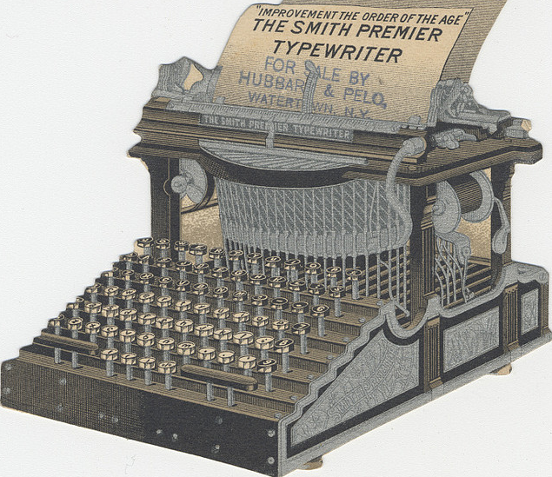
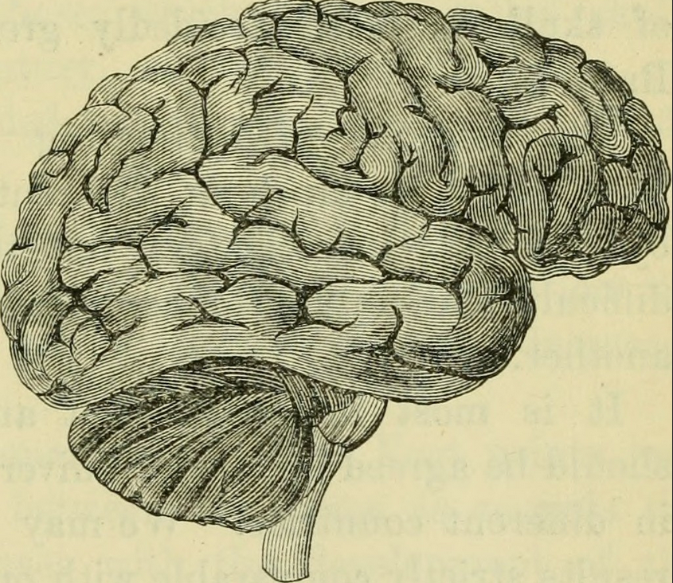
Data User Guides
Notes:
Original purpose
History, standards, and format
Organizational context
Work flow
Things to know, including limitations
How others are using the data

Slide 39
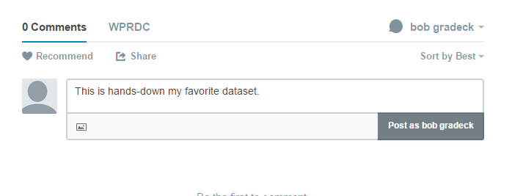
Feedback Mechanisms

Slide 40
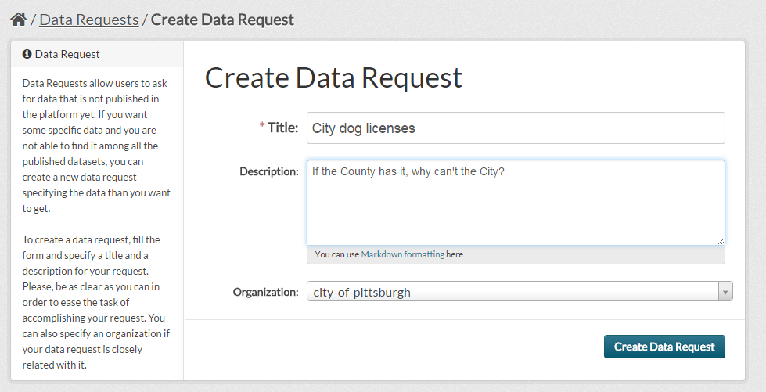
Make it Easier to Request Data

Slide 41
7. Information infrastructure is often an afterthought.
http://hpwren.ucsd.edu/a_and_d.html
Notes:
Growing demand for information
Raw data
Aggregate data (reports)
Publishers not equipped to respond to data requests,
Knowledge of data use not always shared
Ad-hoc development of data ecosystem - few strategic capacity investments and lack of infrastructure
http://hpwren.ucsd.edu/a_and_d.html

Slide 42

Legal Infrastructure
Partnership Agreement
Data Deposit Agreement
Terms of Use
Data License or Public Domain Dedication
Notes:
https://www.flickr.com/photos/citizensheep/3613179465/in/photolist-6vhunF-bUjXg2-8S5zLf-a5QJN-ajzocM-3qhgd-4v8hTt-9ukSAr-6z1Je1-9C1C8N-dveXaK-yAsDWx-9SWV2C-kyp3v-8ay7cX-ei22wQ-kyp4E-6udia5-4CCVd5-5E211Q-are7f7-gZwVV7-9K5Vva-awRrL-4vcoWW-xxb33p-7R3k4R-5FnYh6-yfQcRp-qNAcaf-xYeaVQ-t9npM-6KXdb-9HNrRU-edXPKH-eeqpDn-wYw3Ro-9jU8xd-ydvJUN-2s7JkY-5tSHss-6tqHVV-bwKzVQ-9pSoYT-aj7mW9-aEg8wY-LVKWP-4zkjzB-yfQgP4-77hugx

Slide 43

People Infrastructure
Regional Data Center Staff
UCSUR Staff
Carnegie Mellon Friends
Allegheny County Government Solutions Engineering Team
City of Pittsburgh Government Solutions Engineering Team
Pitt Digital Scholarship Team

Slide 44
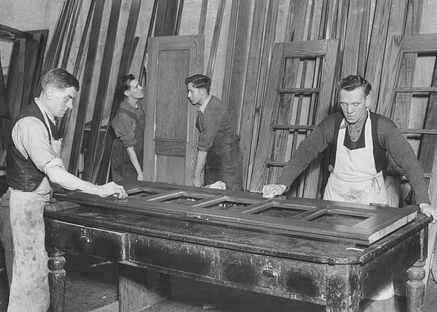
Data Infrastructure: Open Data Portal
Open source (CKAN)
Leverages University servers
Federated model
Search
Download
API
Notes:
Search process based on fit with RDC federated model, vendor quality, features, and long-term sustainability. CKAN, leverage internal University assets.

Slide 45
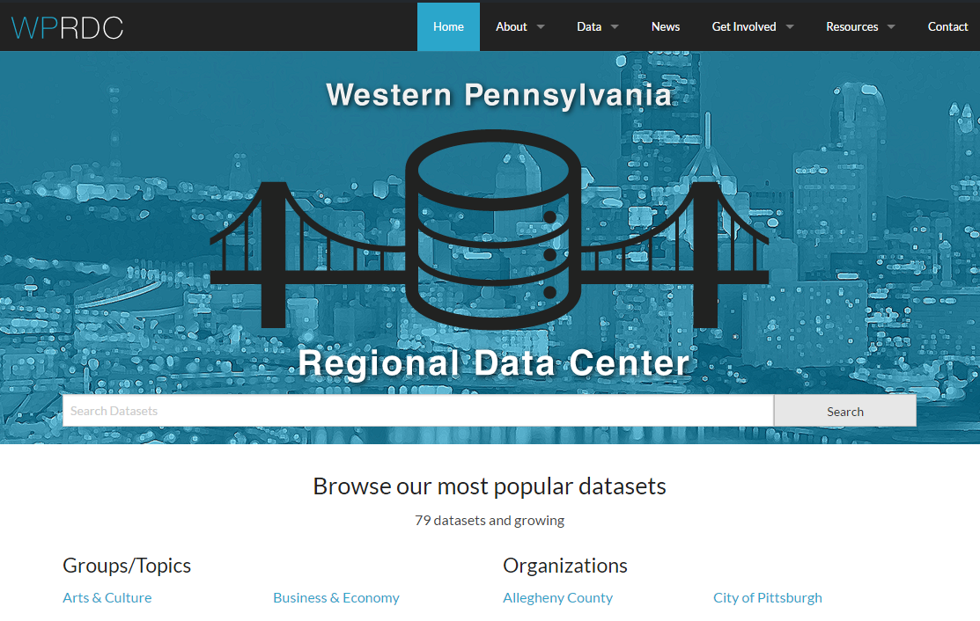

Slide 46
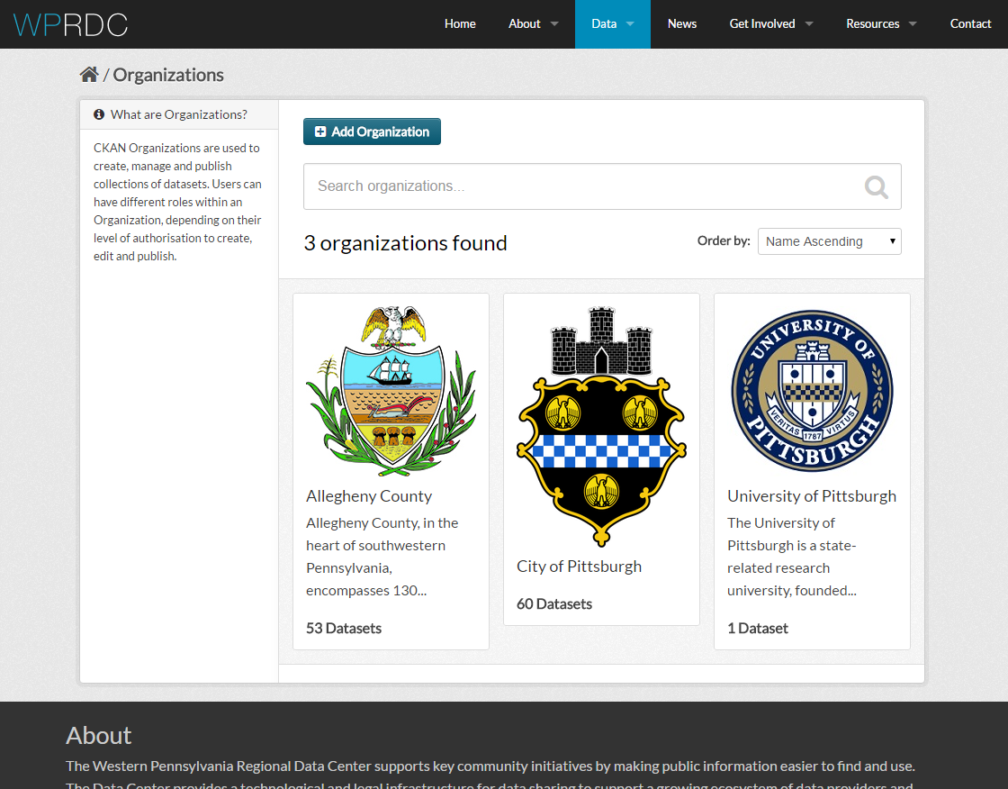

Slide 47
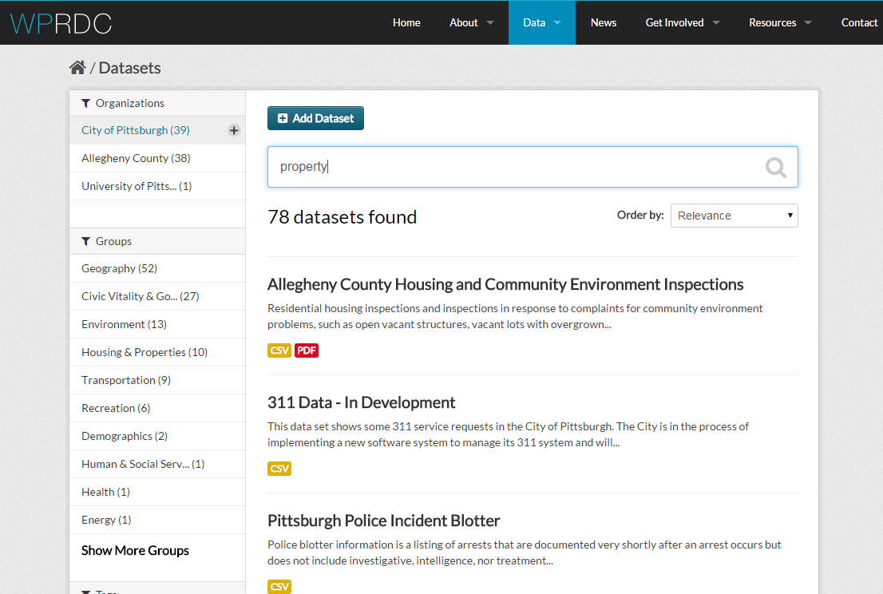

Slide 48
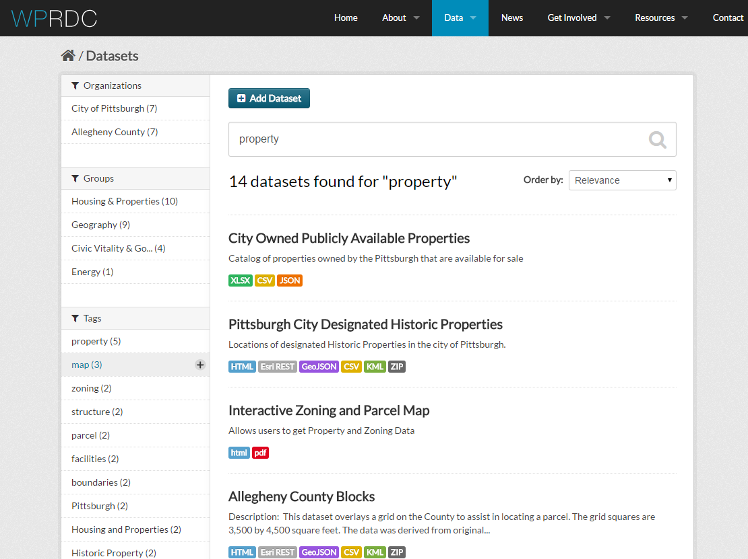

Slide 49
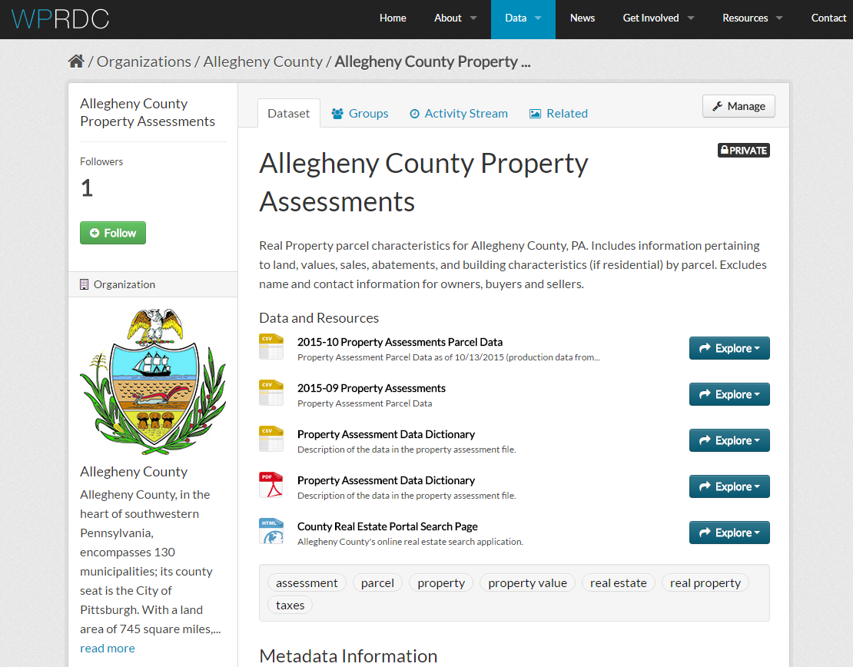

Slide 50
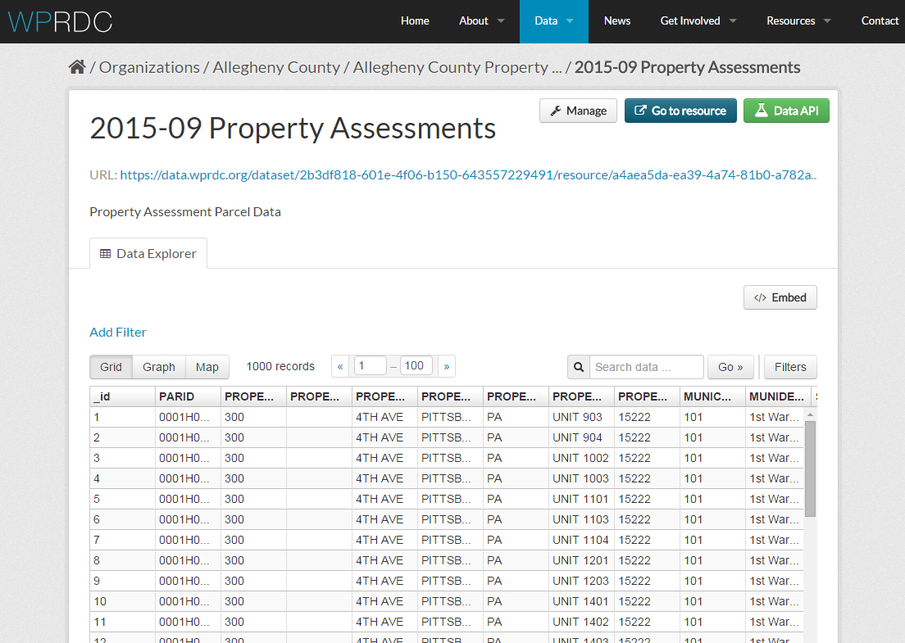
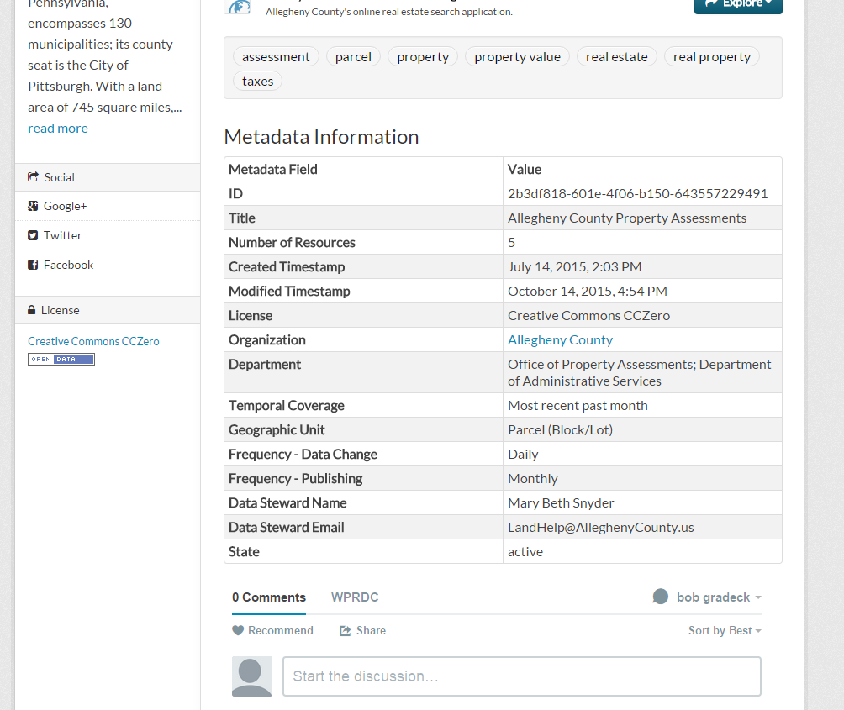

Slide 51

What were the most-popular datasets in 2015?

Slide 52
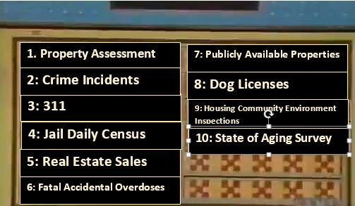

Slide 53
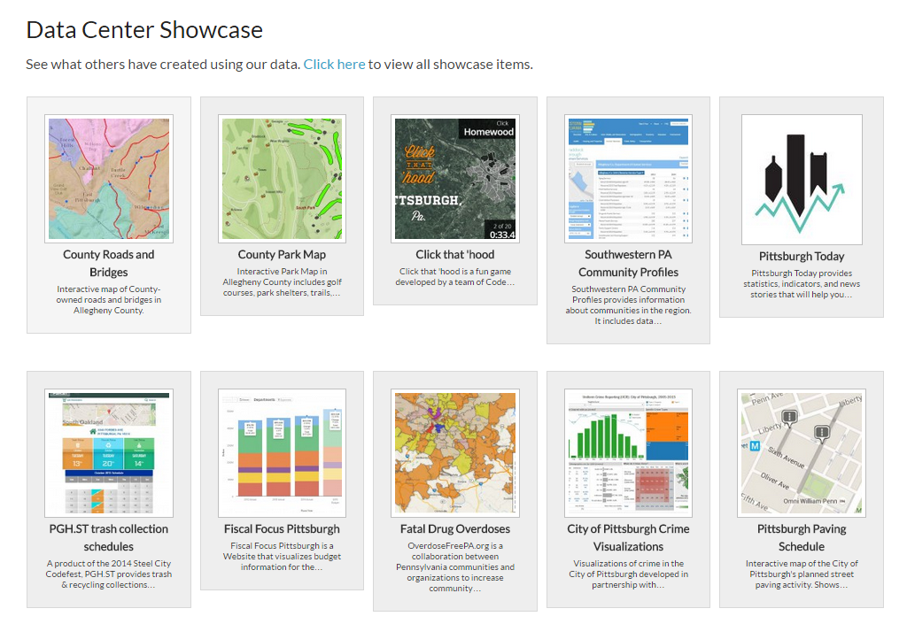

Slide 54
8. The role of an information intermediary is more important than ever.
http://hpwren.ucsd.edu/a_and_d.html
Notes:
Growing demand for information
Raw data
Aggregate data (reports)
Publishers not equipped to respond to data requests,
Knowledge of data use not always shared
Ad-hoc development of data ecosystem - few strategic capacity investments and lack of infrastructure
http://hpwren.ucsd.edu/a_and_d.html

Slide 55

We’re Live!
www.wprdc.org
@WPRDC
wprdc@pitt.edu
Notes:
https://www.flickr.com/photos/aris1983/15285382495/in/photolist-phHzFv-69TSU-dGUQmD-n8SwWz-k4XjcK-bGiyL-6ALV48-z6jL3-5j2uD9-hb989-xKnL8-67kVG-KQJwS-3Lg5dz-7CPj5z-3dYiAE-8G8gk4-z6jLa-z6jLd-n8SqY2-gchSE-6zZ2MB-fZ54L-68Kf8D-dH1fDE-296Se4-n8TaHv-4sCgxf-28Ndz9-sgpK5-fxbuXm-6fhdDa-dH1fzQ-md82B-r15j-5jZX5-4syg88-4syfwt-w8JoM-4sygpa-eger8u-4sye6V-3Lg5dR-oRrxp-9DhyTe-gQxJW-4sCjSW-bzKKcx-so2Jr-6dMUyn

